Slide 1

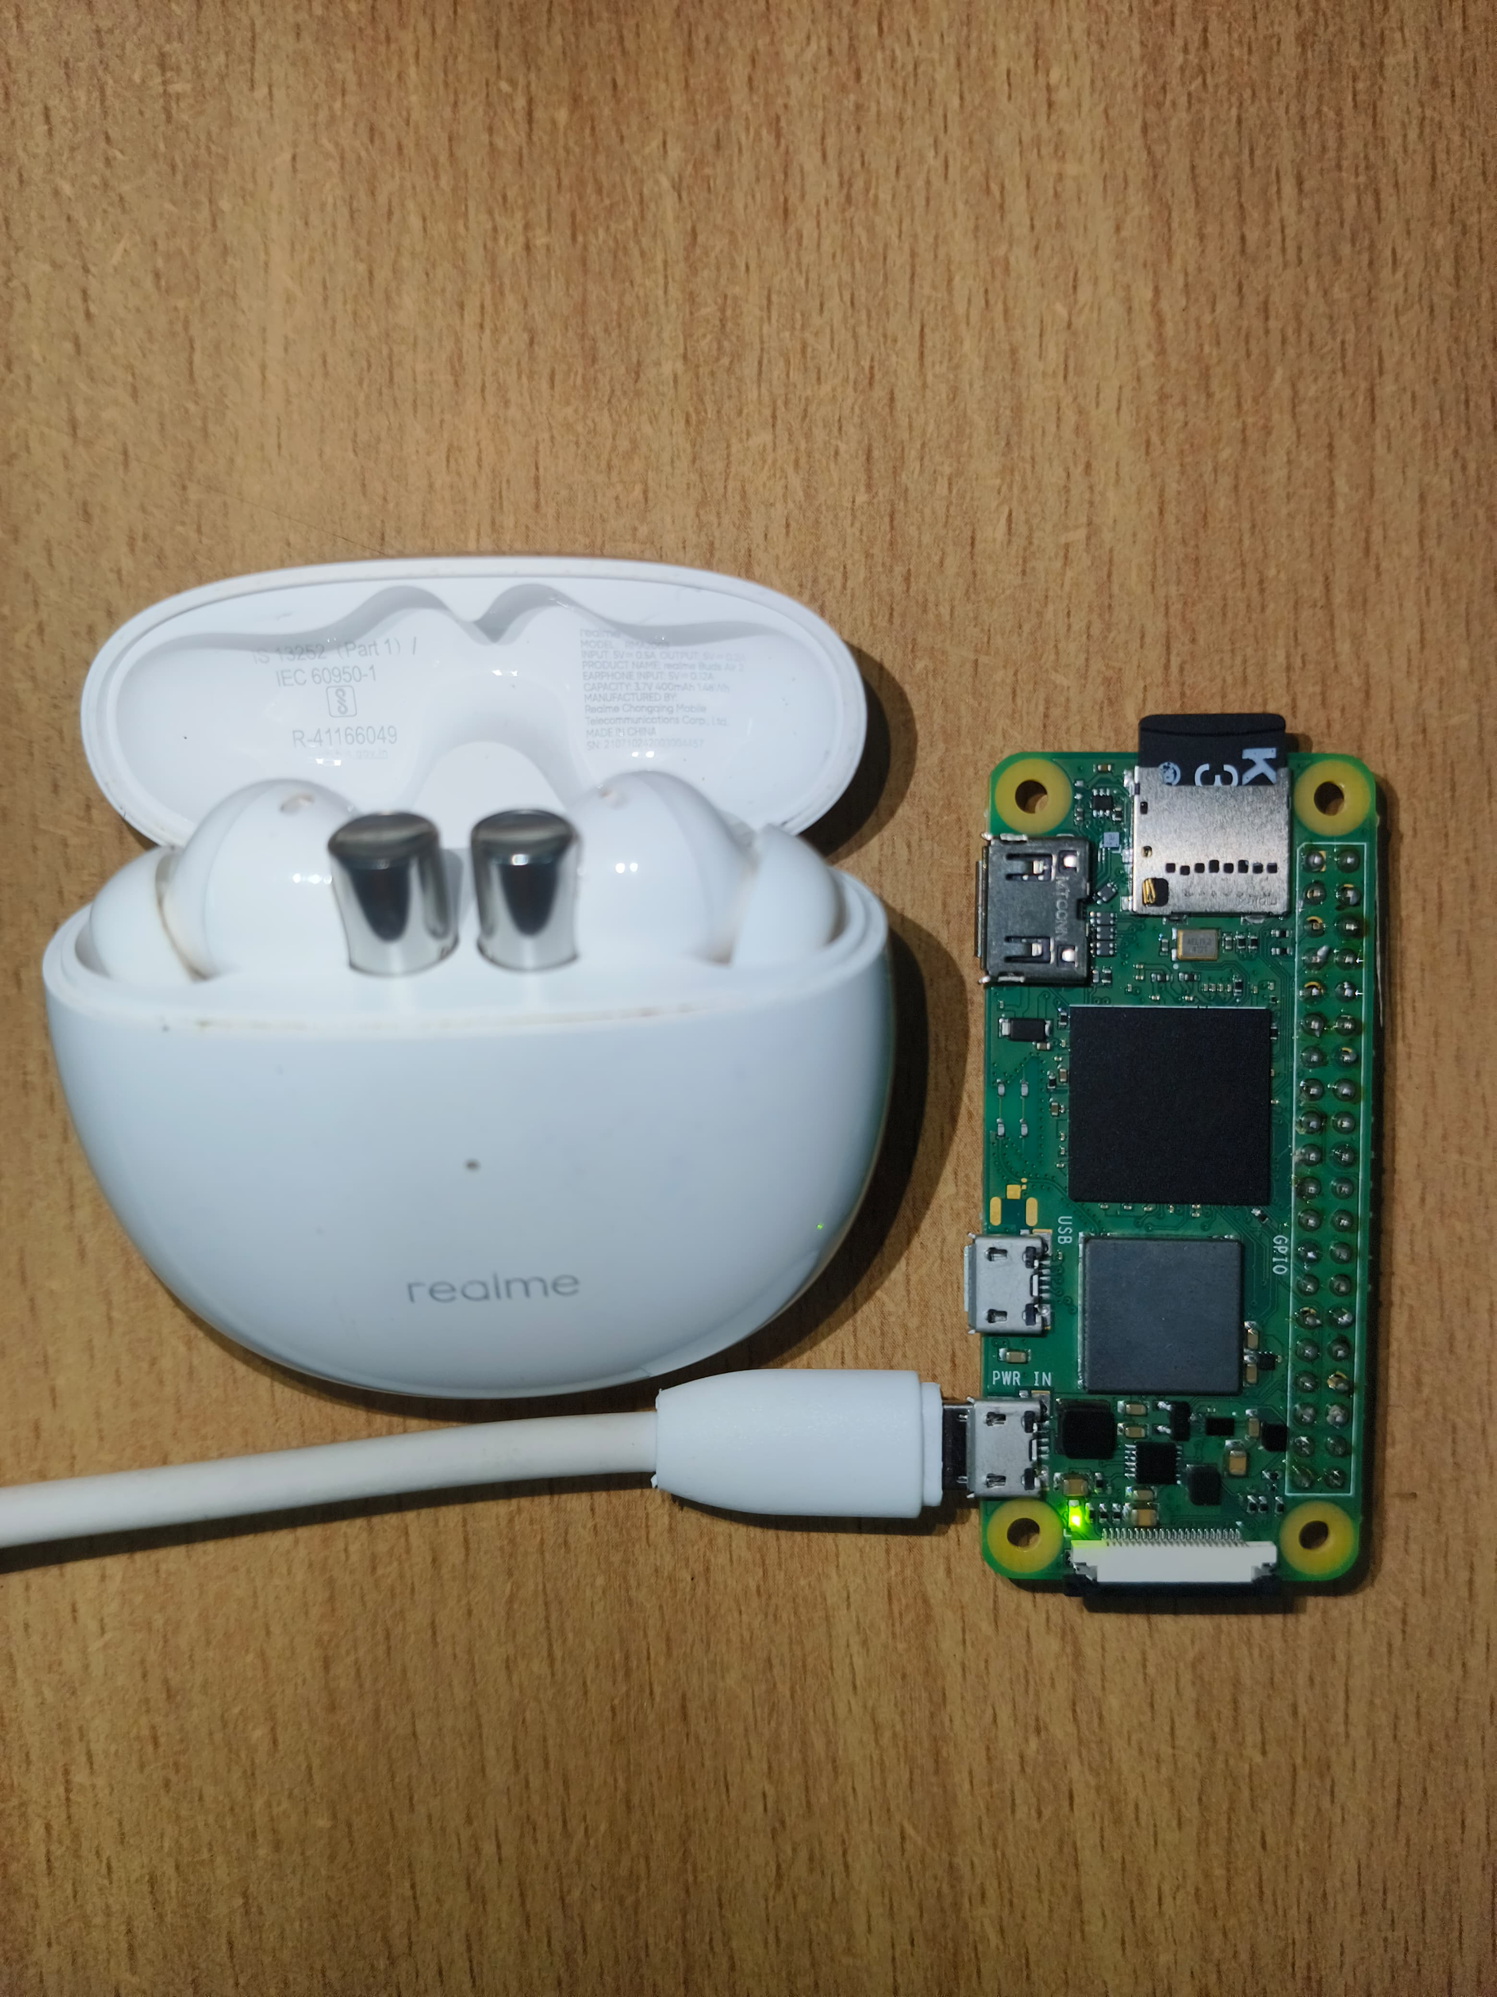







SOE , SOCSE & SOIS
INNOVATIVE PROJECT USING RASPBERRY PI (ECE2011)
Ear Electronic Device For Tinnitus Frequency Finding and Adjusting to Provide Relief To Tinnitus Suffering Patient
These are small electronic gadgets that generate specific sounds to mask or override the ringing of tinnitus. They offer various features to customize the sound output according to the user's preferences .These specialized electronic devices emit soothing sounds, effectively masking or covering up the perceived tinnitus noises. They offer a variety of sound options, ranging from white noise, nature sounds, or customized tones to match an individual's preference .The ultimate goal is to achieve habituation, not only in regard to the perception of tinnitus but, more importantly, to the emotional response associated with tinnitus.
IPR - 217
3rd & 4th
JUNE 2024
SHUBHAM KUMAR
KIRAN T B
GURUPADESHWAR
HARIKRISHNA
MANJUNATH ROYAL
MURALIKRISHNA U
DR.MOHAMMAD SHAHANAWAZ HUSSAIN
20221CSE0721
DEPT OF SOCSE
20221CSE0686
DEPT OF SOCSE
20221CSE0672
DEPT OF SOCSE
20221CSE0674
DEPTOF SOCSE
20221CSE0690
DEPT OF SOCSE
20221ECE0186
DEPT OF SOE
ASSISTANT PROFFESSOR
DEPARTMENT OF ELECTRONICS & COMMUNICATION ENGINEERING

